Slide 1

Biochem 3BP3
Sequence Similarity and Searching
Week of Sept 20, 2021

Slide 2
Why Sequence Analysis?
I have obtained a DNA sequence via PCR and Sanger sequencing – did I amplify the right sequence?
I have been sequencing a genome and have predicted Open Reading Frames and I want to know what they encode
I want to find my gene of interest in a genome sequence
I want to predict functional domains or motifs for my protein sequence
I want to know which regulatory binding sites are 5’ of my gene

Slide 3
There are many methods – we’ll focus on three
Local sequence alignment, e.g. BLAST
Hidden Markov Models, e.g. Pfam/Hmmer
Motif detection, e.g. PROSITE & PSSMs
Course Goal – understand how they work and how they differ

Slide 4
Basic Local Alignment Search Tool (BLAST)
My Sequence
(query)
Database of sequences
(subjects)
“hits”

Slide 5
Basic Local Alignment Search Tool (BLAST)
BLAST is one of the workhorses of bioinformatics
An approximation of the Smith-Waterman algorithm with an emphasis on efficiency and generalization
Published in 1990
DNA sequence databases were coming online and growing in size
accessible computational power was a concern so a ‘fast’ algorithm was an important advance
By 2000 fast computer chips and affordable parallel computing (i.e. many processors) made high-throughput BLAST very workable
Today, advances in Next Generation Sequencing are exceeding Moore’s Law
BLAST is becoming slow again not because of the algorithm but because of the size of databases
This is an active time in new algorithm development (e.g. BLAT, DIAMOND)

Slide 6
Basic Local Alignment Search Tool (BLAST)
A great deal of computer science and mathematics are inside BLAST
Scoring matrices
Search heuristics
Processor and memory usage
Database formatting and indexing
Data and File formats (INPUT and OUTPUT)
Key Concepts
Searching for local alignment (versus global alignment)
Caveats for prediction of function
What is your question? “sequence space”
BLASTN, BLASTP, BLASTX, TBLASTN, TBLASTX
Similarity scoring – bitscore versus percent identity
Use of substitution matrices
Significance and the Expectation value (e-value)

Slide 7
Before BLAST: Smith-Waterman
dynamic programming alignment algorithms to compare the query against each sequence in the database
each comparison is an exhaustive comparison of each nucleotide or amino acid against all others
it won’t miss anything, but processing and memory intensive

Slide 8
Basic Local Alignment Search Tool (BLAST)
novel decrease in the search space
creates a “word list” from the query sequence with words of a specific length (w)
local alignments only explored where “words” have complete match to the query
short word matching is very amenable to computing – fast and lower memory needs

Slide 9
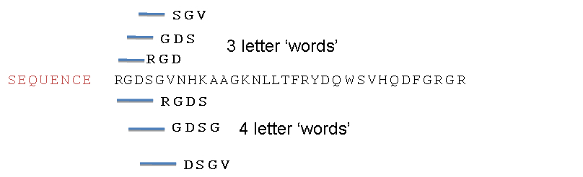
Basic Local Alignment Search Tool (BLAST)
smaller word sizes provide better resolution but there are more of them so they increase analysis time.
BLAST defaults (w=11 for DNA, w=3 for protein) are often sufficient – but not always!

Slide 10
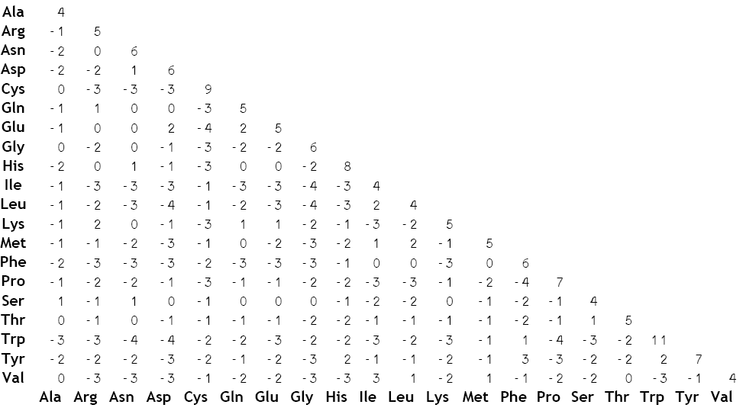
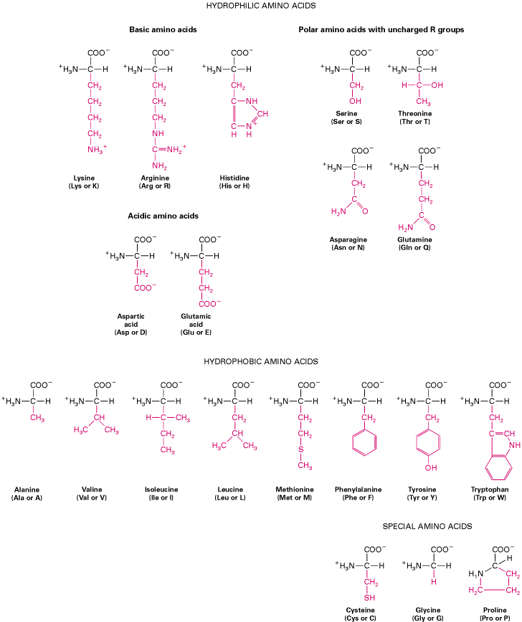
How does BLAST determine if there is match?
It uses a cut-off score based on a scoring matrix
BLOSUM62 matrix (BLOcks SUbstitution Matrix) reflects the relative rate of substitution among all 20 amino acids observed in conserved regions (no more than 62% similarity) of known protein sequences.
BLOSUM62 is the BLAST default. Since is it based on conserved regions with 62% similarity or less it is among the best for detecting most weak protein similarities.
Other BLOSUM or PAM matrices exist for detection of less or more divergent proteins.
conservative = similar physico-chemical properties

Slide 11
BLAST use of scoring matrix
Query
Query words
Seed
Alignment extended as long as the score doesn’t go below the cut-off. Called a High Scoring Pair (HSP)

Slide 12
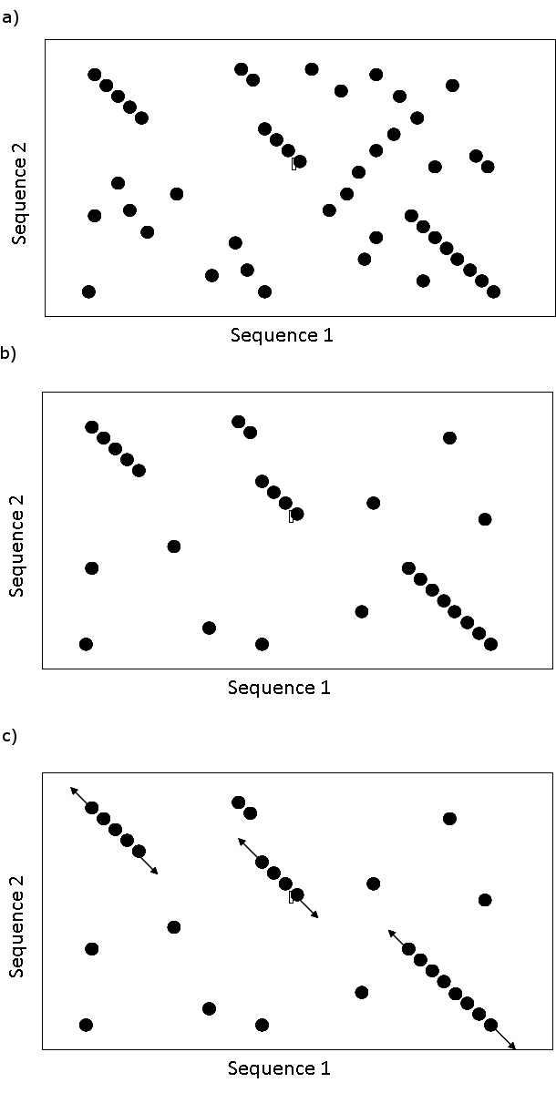
Basic Local Alignment Search Tool (BLAST)
the seed alignment (w) is then extended based on extension / scoring criteria – defaults are often used
extension is tolerant of gaps
by using seed alignments, BLAST solves local alignments within the query/subject pair – not alignment along the entire sequence
local alignments are called a High Scoring Pair (HSP). The example at the right has three HSPs.

Slide 13


Slide 14
A High Scoring Pair (HSP)
219 – (2) + 1 gap = 218
3rd amino acid is a part of the alignment

Slide 15
A High Scoring Pair (HSP)
conservative change
conservative = similar physico-chemical properties

Slide 16
A High Scoring Pair (HSP)
exact matches
exact matches +
conservative changes
gaps
conservative = similar physico-chemical properties

Slide 17
A High Scoring Pair (HSP)
The bit score gives an indication of how good the alignment is; a bit is a measure of information content; the higher the score, the better the alignment. Bit score uses identity, positives, and gaps (i.e. all data).
Bit score is independent of query sequence length and database size (i.e. normalized) allowing comparison among different searches or databases.

Slide 18
A High Scoring Pair (HSP)
The expectation value (e-value) estimates the likelihood that a given sequence match is purely by chance. The lower the expectation value, the less likely the database match is a result of random chance and therefore the more significant.
E-value is a function of database size – how good is the database’s sample of “sequence space” to determine random matches?

Slide 19
A High Scoring Pair (HSP)
As a database grows, the same search will produce an altered expectation value. Different sized databases will produce different expectation values for the same HSPs.
There is no “best” expectation value but some generalizations are used: e⁻¹⁰ or smaller is worth examining; 0.01 or larger is noise.

Slide 20
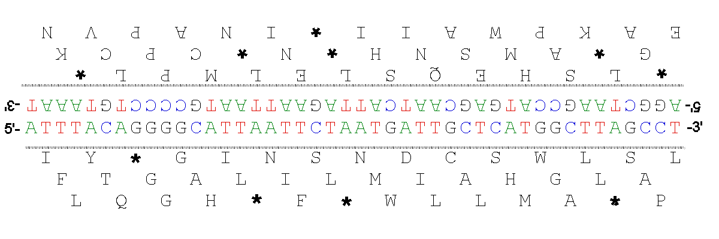
BLAST Programs
BLASTN – search a nucleotide database with a nucleotide query to find nucleotide HSPs
BLASTP – search a protein database with a protein query to find protein HSPs
BLASTX – search a protein database with a nucleotide query to find protein HSPs (translate the query in all six reading frames)

Slide 21
BLAST Programs
BLASTN – search a nucleotide database with a nucleotide query to find nucleotide HSPs
BLASTP – search a protein database with a protein query to find protein HSPs
BLASTX – search a protein database with a nucleotide query to find protein HSPs (translate the query in all six reading frames)
TBLASTN – search a nucleotide database with a protein query to find protein HSPs (translate the database in all six reading frames)
TBLASTX – search a nucleotide database with a nucleotide query to find protein HSPs (translate the database & the query in all six reading frames)

Slide 22
BLAST is not Functional Biology
A local alignment (HSP) found by BLAST may have little to do with protein function
BLAST knows about nucleotides, amino acids, and gaps but does not understand functional domains; it will not even detect functional domain similarity if it is outside of BLOSUM62 range
Multi-domain proteins can give mis-leading BLAST results:
an ANT(3'')-AAC(6’) fusion protein will have BLAST hits to three types of proteins:
other ANT(3'’)-AAC(6’) proteins
ANT(3’’) proteins
AAC(6’) proteins
If the AAC(6’) domain is poorly conserved, the query ANT(3'')-AAC(6’) fusion protein will only have good HSPs to:
ANT(3’’) proteins

Slide 24
Hidden Markov Models (HMMs)
My Sequence
Database of HMMs
HMMER
“hits”

Slide 25
Hidden Markov Models (HMMs)
HMMs are not DNA or protein sequences but are models of how specific DNA or protein sequences are known to vary
e.g. an HMM for a iron hydrogenase domain
A “hit” means your query sequence has an adequate fit to that model of variation
Models are trained using real data, e.g. a sample of hydrogenase sequences
Markov Models are probabilistic
every query has a probability of “fit” to the model
the probability is a function of a linear series of ‘labeling problems’
Sequence HMMs focus on states with:
Emission probabilities (nucleotide / amino acid)
Transition probabilities (another nucleotide / amino acid or a gap)

Slide 26
A simple DNA HMM
ACA---ATG
TCAACTATC
ACAC--AGC
AGA---ATC
ACCG--ATC
5 species have slightly different DNA binding sites for a regulatory protein

Slide 27
ACA---ATG
TCAACTATC
ACAC--AGC
AGA---ATC
ACCG--ATC
.4
A .2
C .4
G .2
T .2
state
state
.6
.6
A .8
C
G
T .2
A
C .8
G .2
T
A .8
C .2
G
T
A 1
C
G
T
A
C
G .2
T .8
A
C .8
G .2
T
1.0
1.0
.4
1.0
1.0

Slide 28
ACA---ATG
TCAACTATC
ACAC--AGC
AGA---ATC
ACCG--ATC
.4
A .2
C .4
G .2
T .2
emission
transition
.6
.6
A .8
C
G
T .2
A
C .8
G .2
T
A .8
C .2
G
T
A 1
C
G
T
A
C
G .2
T .8
A
C .8
G .2
T
1.0
1.0
.4
1.0
1.0

Slide 29
ACA---ATG
TCAACTATC
ACAC--AGC
AGA---ATC
ACCG--ATC
.4
A .2
C .4
G .2
T .2
.6
.6
A .8
C
G
T .2
A
C .8
G .2
T
A .8
C .2
G
T
A 1
C
G
T
A
C
G .2
T .8
A
C .8
G .2
T
1.0
1.0
.4
1.0
1.0

Slide 30
ACA---ATG
TCAACTATC
ACAC--AGC
AGA---ATC
ACCG--ATC
.4
A .2
C .4
G .2
T .2
.6
.6
A .8
C
G
T .2
A
C .8
G .2
T
A .8
C .2
G
T
A 1
C
G
T
A
C
G .2
T .8
A
C .8
G .2
T
1.0
1.0
.4
1.0
1.0

Slide 31
ACA---ATG
TCAACTATC
ACAC--AGC
AGA---ATC
ACCG--ATC
.4
A .2
C .4
G .2
T .2
.6
.6
A .8
C
G
T .2
A
C .8
G .2
T
A .8
C .2
G
T
A 1
C
G
T
A
C
G .2
T .8
A
C .8
G .2
T
1.0
1.0
.4
1.0
1.0

Slide 32
ACA---ATG
TCAACTATC
ACAC--AGC
AGA---ATC
ACCG--ATC
.4
A .2
C .4
G .2
T .2
.6
.6
A .8
C
G
T .2
A
C .8
G .2
T
A .8
C .2
G
T
A 1
C
G
T
A
C
G .2
T .8
A
C .8
G .2
T
1.0
1.0
.4
1.0
1.0

Slide 33
ACA---ATG
TCAACTATC
ACAC--AGC
AGA---ATC
ACCG--ATC
.4
A .2
C .4
G .2
T .2
.6
.6
A .8
C
G
T .2
A
C .8
G .2
T
A .8
C .2
G
T
A 1
C
G
T
A
C
G .2
T .8
A
C .8
G .2
T
1.0
1.0
.4
1.0
1.0

Slide 34
ACA---ATGG
TCAACTATC
ACAC--AGC
AGA---ATC
ACCG--ATC
P(ACAATG)=0.0328
.4
A .2
C .4
G .2
T .2
.6
multiply the probabilities!
.6
A .8
C
G
T .2
A
C .8
G .2
T
A .8
C .2
G
T
A 1
C
G
T
A
C
G .2
T .8
A
C .8
G .2
T
1.0
1.0
.4
1.0
1.0

Slide 35
ACA---ATGG
TCAACTATC
ACAC--AGC
AGA---ATC
ACCG--ATC
P(ACAATG)=0.0328
P(ACCGATC)=0.006
.4
A .2
C .4
G .2
T .2
.6
multiply the probabilities!
.6
A .8
C
G
T .2
A
C .8
G .2
T
A .8
C .2
G
T
A 1
C
G
T
A
C
G .2
T .8
A
C .8
G .2
T
1.0
1.0
.4
1.0
1.0

Slide 37
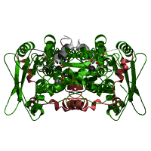
Pfam Iron Hydrogenase HMM
334 iron hydrogenases in the seed alignment
D9QTQ6_ACEAZ/525-580 MDV--KAKRAEALYQTD---KA-NTI--RKSHENPQIIKLYE---D----YL-GE-P-L-----SSDSHHLLHTSYQER
E3DPJ1_HALPG/515-570 NEK--KEKRGSGLSNID---DS-SKI--RKSHENPQIIKLYE---E----FL-GE-P-L-----GGESHHLLHTKYKAR
E4RJ60_HALHG/516-571 YEK--KVKRGVGLSGID---DK-SAV--RKSHKNPQVIKLYK---E----FL-GK-P-L-----SGESHHLLHTTYKSR
Q0AVN1_SYNWW/44-102 DDY--IAKRAAGLYTLD---ES-MAI--RKSHENPEVIQIYQ---D----FL--S-P-GKLECVSPKAHHLLHTKYGQ-
D7CNL1_SYNLT/44-102 DDY--IAKRAQGLYTLD---EK-MTI--RKSHENPEIIQLYK---D----FL--S-P-GEVKPMSEKAHHLLHTRYGQ-
L0KCP1_HALHC/517-572 KEI--KAKRGQGLYNID---QS-DKI--RKSHENPEIKKLYE---D----FL-GA-P-L-----SEKAHHLLHTNYQKR
R5AAQ0_9FIRM/470-524 EEL--YGVRGERLYTLD---AE-NPM--RFAHENPEVQALYH---E----YL-GE-P-L-----GETAHHLLHTDHKA-
F7V3Y0_CLOSS/515-570 KEM--AASRAPILYAFD---QI-TDL--RFSHENPSITKVYS---E----YL-GE-P-L-----SEKSHHLLHTDHHAW
R7B2L8_9BACE/516-570 QEL--AKDRAPILYSLD---RS-KNI--RFSHENPDVLKMYE---E----FF-EK-P-N-----SPVAHKLLHTDHHA-
R5TQ56_9FIRM/517-570 -EL--ADVRGRNLYKLD---KK-NPL--RFSHENPSVIKAYE---D----FF-EK-P-L-----SHKSHELLHTDHEA-
R6G054_9FIRM/519-572 KEM--AEIRSKNLYFLD---SQ-NER--RFSHENPEVLKTYE---E----YL-EK-P-L-----SRMSHKLLHTDHH--
F4GHP6_SPHCD/517-571 -EL--ASTRADVLYGLD---KV-DNL--RFSHENPSVLKAYE---S----FF-GK-P-L-----GHKCHELLHTDHHAW
R6K3U5_9FIRM/237-290 -DK--VAERCKVLYGLD---KV-NNV--RFSHENPEVLQCYR---D----YF-KE-P-L-----SEKSHELLHTSHTV-
R7BDK2_9FIRM/518-573 VEM--AADRAKELYKLD---KN-KQI--RFSHCNPEIHTIYK---E----YF-GK-P-L-----SPVSHHLLHTDHKYR
R6A2A7_9ACTN/541-595 -EL--AAERGQVLWGLD---AK-ADI--RFSHENPGVQACYR---E----FL-GA-P-L-----SPLAEELLHTDHHAW
R7D1R5_9ACTN/521-575 VEL--ADERAAVLRALD---HD-AQI--RFSHENPDVAACYR---D----FL-GE-P-L-----SELSEKLLHTDHTA-
G4KSU3_OSCVS/517-571 VEM--AAERGELLWELD---AK-SKI--RFSHENPDIKTLYS---E----YL-KE-P-L-----GKKSHHLLHTDHAA-
R6GQ90_9FIRM/517-572 VEL--AEKRGSVLWSID---KA-SPC--RFSHENPDVRELYR---D----YL-KK-P-L-----SDVSHHLLHTDHQAW
R5D0I3_9FIRM/517-570 TEM--AEARGNVLWSID---KK-SPV--RFSHENPEVQTLYR---E----YL-RA-P-L-----SGRSHHLLHTDHE--
R6Q6Y7_9FIRM/517-570 --Q--AERRGNHLYFLD---DI-ANL--RFSHENPAIQALYK---N----FL-GE-P-L-----GEKAHHLLHTDHTAW
R6RTM0_9FIRM/518-571 QEL--AEERGSSLYFLD---RD-TEI--RFSHDNPDIQNLYE---E----FF-EK-P-L-----SHRAHQLLHTEHQ--
Q73MB6_TREDE/520-573 GEL--AVKRGSNLYFID---KN-SKV--RYSHENECIKALYN---D----FF-EK-P-N-----SHKAHSLLHTDHF--
R5J469_9CLOT/520-573 -EM--AFERGKNLYFLD---EN-ADI--RRSHENPDVKALYD---N----YF-EQ-P-L-----SHKSHMLLHTDHNK-
D4M4H0_9FIRM/519-573 EEL--AHTRGANLYFLD---KN-AKI--RFSHENQDVMKLYN---D----FL-EK-P-L-----SHKSHMLLHTDHTK-
R6LI15_9FIRM/519-573 EEL--ARTRGENLYFLD---KN-APL--RFSHENPDVLRLYR---D----FF-EK-P-L-----SHKSHMLLHTDHNA-
F0T2S8_SYNGF/456-511 DTI--RTQRSNSLYTLD---KN-AKV--RNSHENTEITQIYK---D----YL-HA-P-M-----SHLAEEILHTEYESR
A5D4I9_PELTS/463-518 DTV--REQRLAALYKAD---ASLSK---RKSYENEEVAALYR---D----FL-GH-P-M-----SELAEELLHTEYHSR
R4KFN4_9FIRM/459-514 DEV--RMQRINSLYQAD---AR-AQR--RESHENAEVLALYQ---N----FL-KH-P-M-----SELAEELLHTKYTDR
F6DPY8_DESRL/455-511 DQV--RQARLNSLYTMD---AKMYKK--RLSHENSEVLQLYK---N----YL-EQ-P-M-----SHLAEELLHTEYTDR

Slide 38
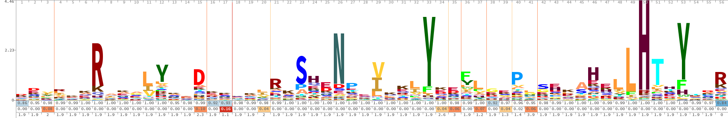
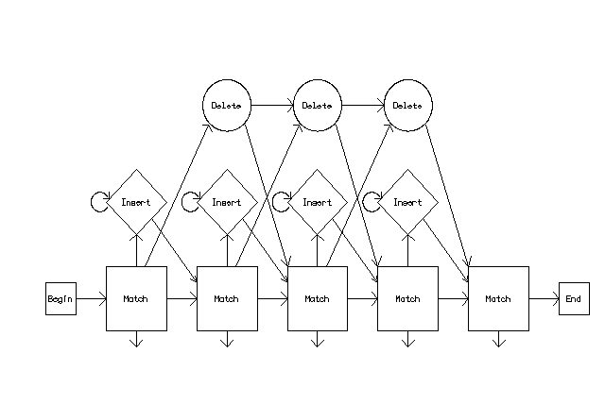
Pfam Iron Hydrogenase HMM
Much sequence variation, but some conservation
HMMER / Pfam has a generalized HMM that can be trained by any protein domain

Slide 39
Pfam Iron Hydrogenase HMM
The HMM is trained using the seed alignment to determine the emission and transition probabilities
HMM A C D E F G H I K L M N P Q R S T V W Y
m->m m->i m->d i->m i->i d->m d->d
COMPO 2.66299 4.87199 2.91679 2.55591 3.66715 3.29500 2.87691 3.09550 2.45416 2.39490 3.84919 3.01061 3.43251 3.03167 2.71247 2.66673 2.90997 3.06188 5.21245 2.88414
2.68618 4.42225 2.77519 2.73123 3.46354 2.40513 3.72494 3.29354 2.67741 2.69355 4.24690 2.90347 2.73739 3.18146 2.89801 2.37887 2.77519 2.98518 4.58477 3.61503
0.15412 5.62693 1.97159 0.61958 0.77255 0.00000 *
1 2.69450 5.20126 1.90404 2.47178 4.68913 3.78335 4.01145 3.75163 2.20418 2.96186 3.33300 2.43140 3.49632 2.59266 3.14923 2.72610 2.90370 2.98968 5.61412 4.41752 1 d - - C
2.68618 4.42225 2.77519 2.73123 3.46354 2.40513 3.72494 3.29354 2.67741 2.69355 4.24690 2.90347 2.73739 3.18146 2.89801 2.37887 2.77519 2.98518 4.58477 3.61503
0.00718 5.47902 5.81517 0.61958 0.77255 0.42007 1.07002
2 2.91083 4.82906 1.58312 1.73987 5.01707 3.82147 3.64171 4.50313 2.01029 3.15122 4.59410 2.83954 4.25294 3.15745 3.12709 2.65971 3.16946 3.83508 6.10447 4.69344 2 d - - C
2.68618 4.42225 2.77519 2.73123 3.46354 2.40513 3.72494 3.29354 2.67741 2.69355 4.24690 2.90347 2.73739 3.18146 2.89801 2.37887 2.77519 2.98518 4.58477 3.61503
0.00559 5.58603 6.30838 0.61958 0.77255 0.42789 1.05522
3 2.63456 4.70051 4.84319 2.98389 2.64502 4.37715 4.37000 1.96988 3.23179 2.30513 3.40557 3.77117 4.64207 4.19062 3.25571 3.40775 2.92268 1.80829 5.12858 2.21226 3 v - - H
2.68582 4.42236 2.77514 2.73093 3.46365 2.40524 3.72482 3.29365 2.67744 2.69351 4.24701 2.90358 2.73751 3.18157 2.89791 2.37890 2.77525 2.98529 4.58488 3.61514
0.08136 2.57205 6.34224 0.67760 0.70894 0.47041 0.98016
4 2.54801 4.72728 4.74569 4.15699 3.82991 4.36365 4.46123 1.93633 2.71591 1.80176 2.81197 4.19038 4.73278 4.00802 1.74668 3.65099 3.31186 2.37869 5.33916 3.48167 6 r - - H
2.68618 4.42225 2.77519 2.73123 3.46354 2.40513 3.72494 3.29354 2.67741 2.69355 4.24690 2.90347 2.73739 3.18146 2.89801 2.37887 2.77519 2.98518 4.58477 3.61503
0.00537 5.62610 6.34845 0.61958 0.77255 0.48306 0.95944
5 2.11055 5.19463 3.13477 2.25423 4.84332 3.10661 3.88848 3.85885 1.98083 2.26284 3.93265 3.22775 4.35588 2.50230 2.73835 2.86546 2.72615 3.35148 6.10956 4.57738 7 k - - H
2.68618 4.42225 2.77519 2.73123 3.46354 2.40513 3.72494 3.29354 2.67741 2.69355 4.24690 2.90347 2.73739 3.18146 2.89801 2.37887 2.77519 2.98518 4.58477 3.61503
0.00536 5.62693 6.34927 0.61958 0.77255 0.48576 0.95510
6 2.03322 4.91437 2.94559 2.42989 5.02036 3.66309 4.04897 3.63439 1.52459 2.77931 3.89988 3.20092 4.15513 2.30684 2.83680 2.92417 3.25333 3.61800 6.11737 4.70998 8 k - - H
2.68618 4.42225 2.77519 2.73123 3.46354 2.40513 3.72494 3.29354 2.67741 2.69355 4.24690 2.90347 2.73739 3.18146 2.89801 2.37887 2.77519 2.98518 4.58477 3.61503
0.00536 5.62693 6.34927 0.61958 0.77255 0.48576 0.95510
7 4.73891 6.64548 5.68057 4.42078 6.41719 5.15128 3.93502 5.55175 2.29408 4.78890 5.71680 4.63644 5.41712 2.87234 0.31067 4.69020 4.75225 5.28095 6.66515 5.69420 9 R - - H
2.68618 4.42225 2.77519 2.73123 3.46354 2.40513 3.72494 3.29354 2.67741 2.69355 4.24690 2.90347 2.73739 3.18146 2.89801 2.37887 2.77519 2.98518 4.58477 3.61503
0.00536 5.62693 6.34927 0.61958 0.77255 0.48576 0.95510
8 1.62426 4.44842 4.26891 3.69735 3.86164 3.13257 4.52444 2.32789 3.39179 2.57955 2.66032 3.91731 4.63345 2.24662 2.85057 3.03169 2.70601 2.61172 5.46972 4.25065 10 a - - C
2.68618 4.42225 2.77519 2.73123 3.46354 2.40513 3.72494 3.29354 2.67741 2.69355 4.24690 2.90347 2.73739 3.18146 2.89801 2.37887 2.77519 2.98518 4.58477 3.61503
0.00536 5.62693 6.34927 0.61958 0.77255 0.48576 0.95510

Slide 40
Pfam Iron Hydrogenase HMM
The HMM is trained using the seed alignment to determine the emission and transition probabilities
Pfam is a collection of many trained HMMs; query sequences are compared to all of Pfam to find the best fitting HMMs

Slide 41
How does searching work?
What does Markov mean?
What is Hidden?
ACA---ATGG
.4
A .2
C .4
G .2
T .2
.6
.6
A .8
C
G
T .2
A
C .8
G .2
T
A .8
C .2
G
T
A 1
C
G
T
A
C
G .2
T .8
A
C .8
G .2
T
1.0
1.0
.4
1.0
1.0

Slide 42
observed
sequence
ACA---ATGG
.4
A .2
C .4
G .2
T .2
state path
.6
.6
A .8
C
G
T .2
A
C .8
G .2
T
A .8
C .2
G
T
A 1
C
G
T
A
C
G .2
T .8
A
C .8
G .2
T
1.0
1.0
.4
1.0
1.0

Slide 43
observed
sequence
ACA---ATGG
Markov Chain – next state emission depends only upon current state, i.e. the model is a linear chain
Since we only know our query sequence, the state path is “hidden”
.4
A .2
C .4
G .2
T .2
Software uses HMMs to determine the state path for a query sequence
state path
.6
.6
A .8
C
G
T .2
A
C .8
G .2
T
A .8
C .2
G
T
A 1
C
G
T
A
C
G .2
T .8
A
C .8
G .2
T
1.0
1.0
.4
1.0
1.0

Slide 44
Hidden Markov Models (HMMs)
My Sequence
Database of HMMs
HMMER
There are many probable state paths for an observed sequence for a HMM
The Viterbi algorithm is guaranteed to find the most probable state path given a sequence and an HMM.
The query generates a probability for every HMM in the database
“hits”

Slide 46
HMMs in Pfam / Hmmer
The HMMER software uses the probability values to calculate:
bit score – a log-odds score of the fit of the query to the HMM; the higher the score, the better the alignment
expectation value - estimates the likelihood that a given match is purely by chance; a function of database size
Pfam website uses a default expectation value cut-off of 1.0

Slide 47
HMMs in Pfam / Hmmer
Pfam HMMs are curated by functional biologists and model functional domains; Pfam HMMs are thus one of the most powerful tools available for prediction of protein function
Caveat – correlations among residues cannot be modeled by HMMs as Markov Chains cannot ‘remember’ earlier states; secondary structure not workable in HMMs

Slide 48
What about finding short sequences?
Short sequences or motifs by definition have less information
Often too short for BLAST (below word size or extension rules)
Not enough information to build an HMM
Easily match random sequences – expectation values break down
Statistical confidence and avoidance of false discovery difficult for reasons listed above – experimental validation often required
Two common bioinformatics questions
Detection of amino acid motifs, e.g. PROSITE database
Detection of DNA binding sites, e.g. JASPAR database
Two common methods
Pattern matching
Position-specific scoring matrix (PSSM)

Slide 49
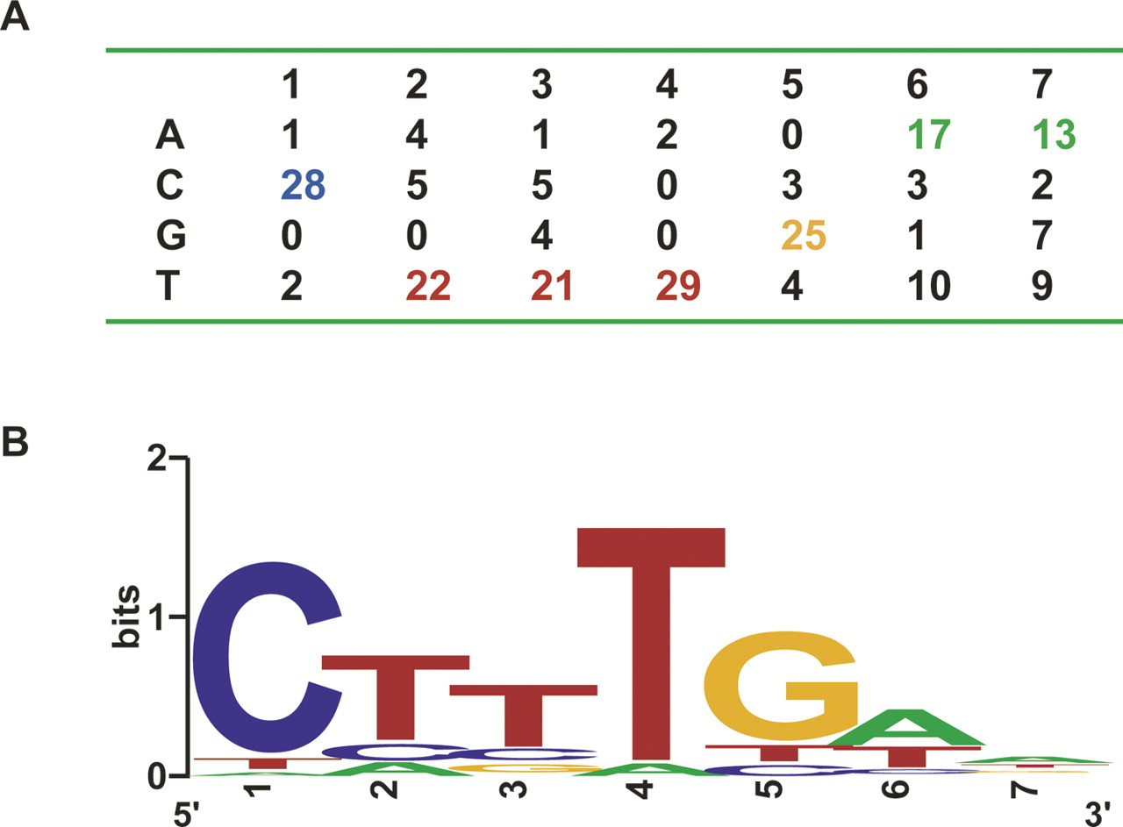
What about finding short sequences?
Pattern matching, e.g. C-x-H-x-[LIVMFY]-C-xx-C-[LIVMYA]
Not statistical – the pattern exists in the subject or not
Frequently important for analysis of proteins (e.g. PROSITE)
Computers are very good at pattern matching – fast!
Universal language for pattern matching – Regular Expressions (RegEx)
Almost exclusively a command-line tool
Position-specific scoring matrix (PSSM)
A pattern with variation based on observation
Also important for analysis of proteins (e.g. PROSITE)
Particularly important for analysis of DNA binding sites (e.g. JASPAR database)
Commonly generated from ChIP-Seq results
Meme/Mast software suite and other suites at the command line
Statistical in nature, but very high false discovery rate!

Slide 50
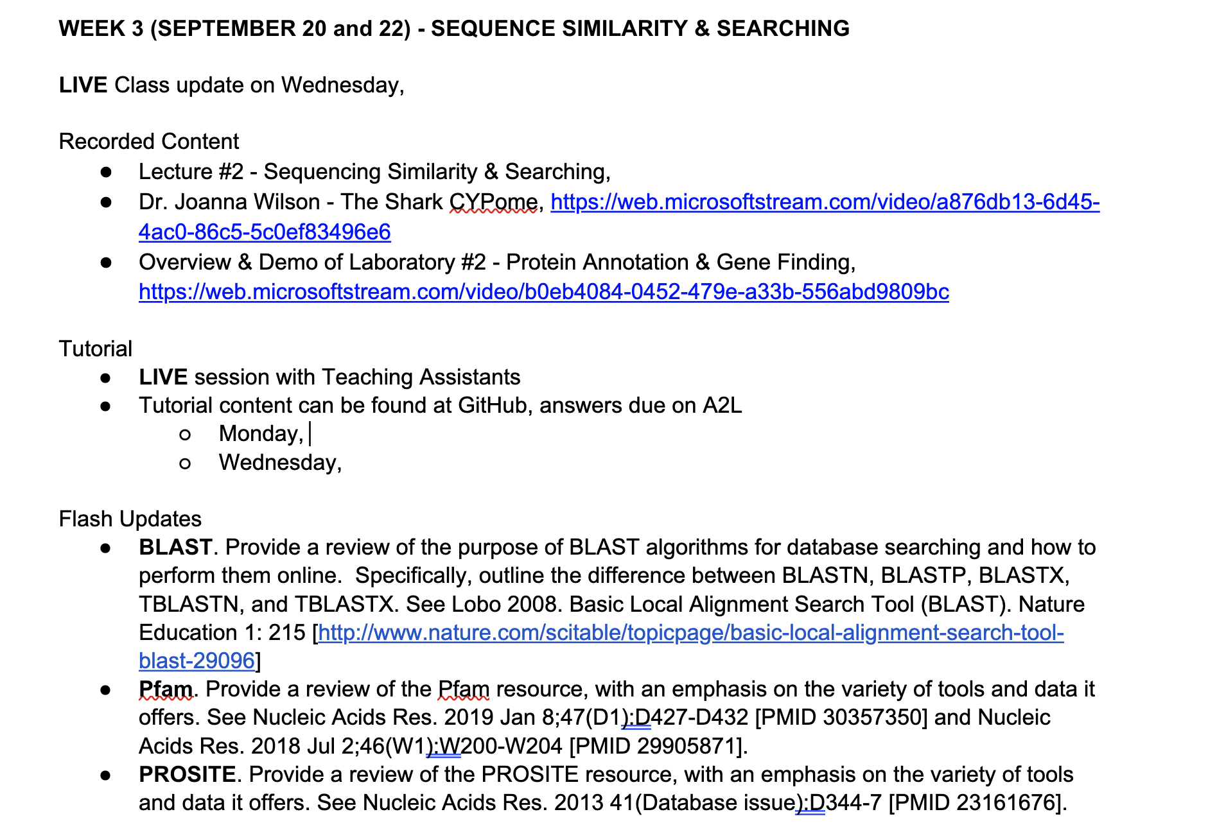
This Week…

